Slide 1
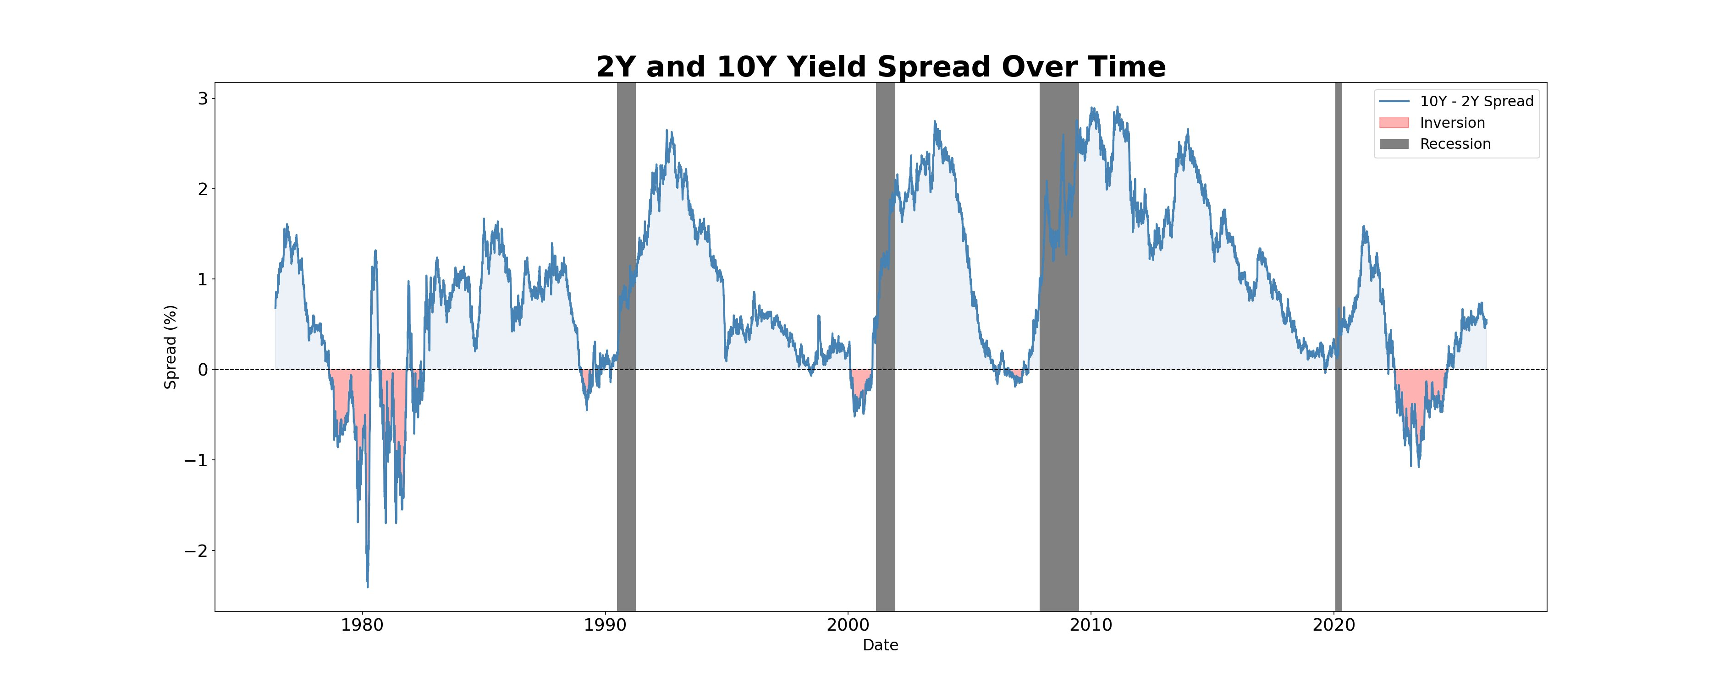
Does the Yield Curve Predict Recessions?
U.S. Treasury Yield Curve Analysis (1977–2025)
3/3
98.8%
0.859
Recessions
Predicted
Variance from
2 PCA Factors
PCA–Spread
Correlation
Key Findings
→ Every recession since 1977 was preceded by a yield curve inversion, typically 12–18 months earlier → The 2022–23 inversion was the deepest on record — yet no clear recession has followed, raising questions about the signal's reliability → PCA shows just 2 hidden patterns explain 98.8% of all daily yield curve movement: level and slope → The slope factor independently rediscovered the 2s10s spread — the same signal economists have watched for decades
2Y vs. 10Y Yield Spread Over Time | Pink = Inversion | Gray = Recession
Main Question: The 2022–23 inversion was the deepest in 40 years. Is the yield curve losing its predictive power, or is a recession still coming?
Data: FRED (St. Louis Fed) | Analysis: Python (pandas, sklearn, matplotlib) | Quant Mentorship Program — Spring 2026 | [Your Name]

